Slide 1

CS544 Final Project
Group 2
Harunobu Ishii

Slide 2
Project Overview
This project aims to visualize the progress of vaccinations against notoriously prevailing COVID-19.
Instead of showing just pure numbers of doses given to citizens in those countries, this analysis factors in their population, vaccination/combination types, geographical regions (Asia/America etc.), and income levels (High/middle etc.).
To do so, I combined the following three different datasets/data-sources into a data-frame:
World Vaccination Progress (As of 19 Feb) from Kaggle
Population-by-Country from Datahub
Income Level from World Bank
In addition, we will see more statistical experiments on data in the dataset, as the report progress toward the end of the report.
World Vaccination Progress (As of 19 Feb) from Kaggle
https://www.kaggle.com/gpreda/covid-world-vaccination-progress
Population-by-Country from Datahub
https://datahub.io/JohnSnowLabs/population-figures-by-country#data
Income Level from World Bank
https://datahelpdesk.worldbank.org/knowledgebase/articles/906519-world-bank-country-and-lending-groups

Slide 3
Outline
Data Profile(P.4)
Do the analysis as in Module3 for at least one categorical/Qualitative variable and at least one numerical/Quantitative variable, show appropriate plots for your data (P.5-9)
Do the analysis as in Module3 for at least one set of two or more variables. Show appropriate plots for your data (P.10)
Draw various random samples of the data and show the applicability of the Central Limit Theorem for this variable (P.11-13)
Pick one variable with numerical data and examine the distribution of the data. Show how various sampling methods can be used on your data. What are your conclusions if these samples are used instead of the whole dataset (P.14)
Implementation of any feature(s) not mentioned in the above specification (P.15 & Plot-ly used)

Slide 4
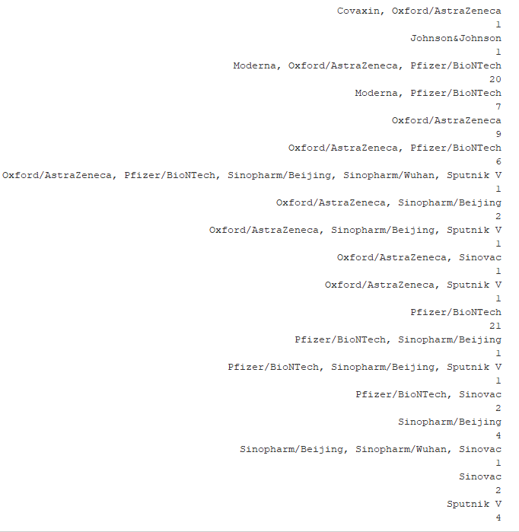
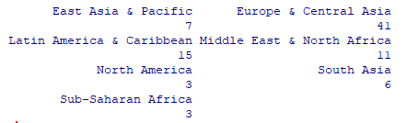
Data Profile
86 countries from 7 different regions
19 different combination of Vaccine types adopted
Three groups of income level amongst those that started vaccinating

Slide 5
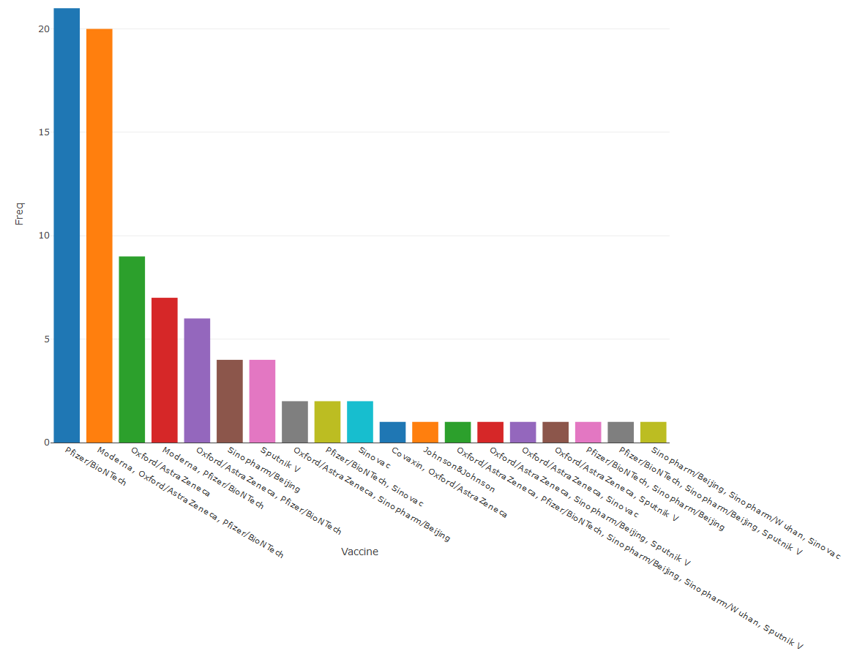
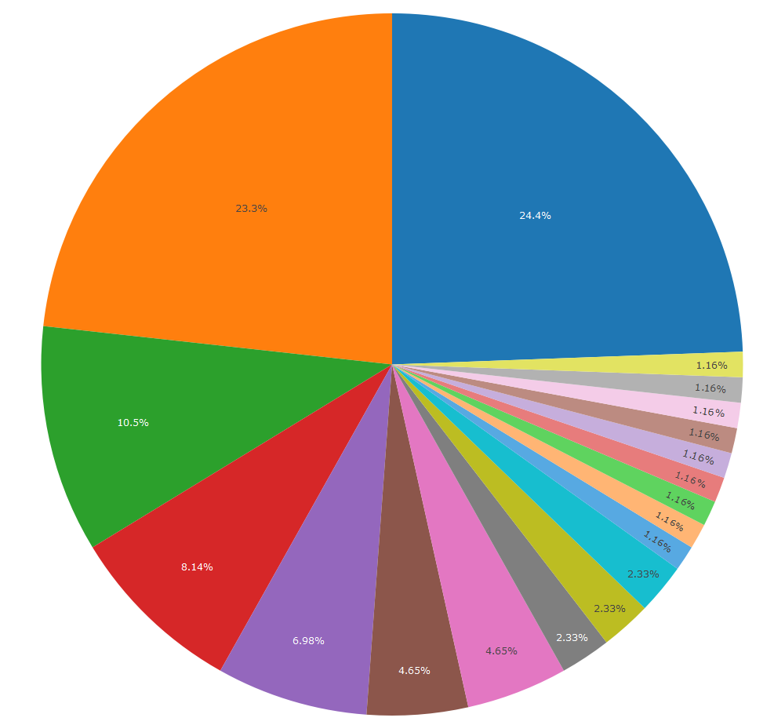

Slide 6
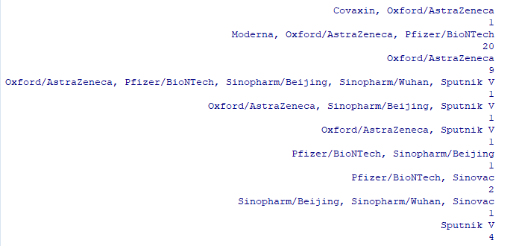
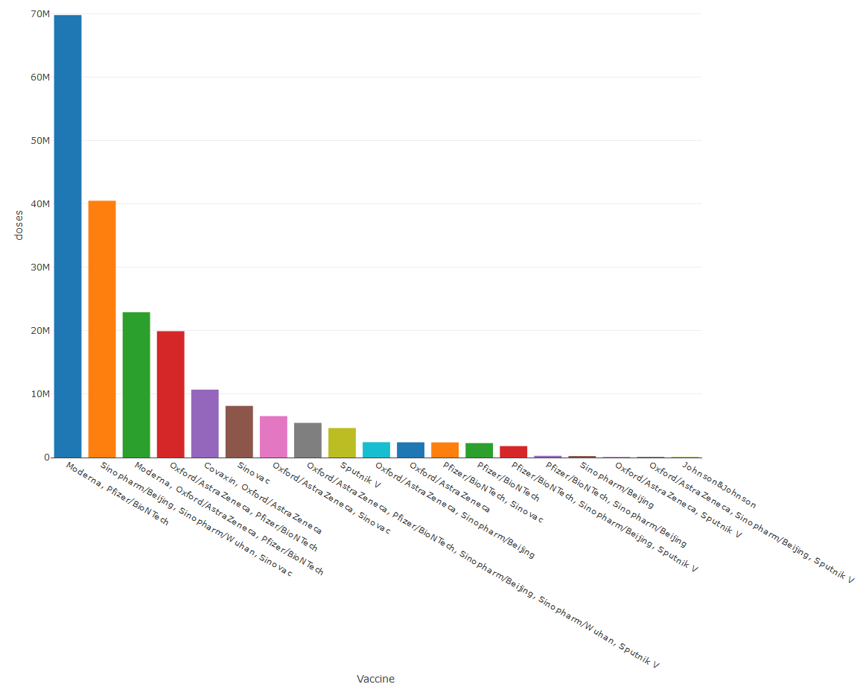
20 different countries
Doses given by Vaccine/combinations
China
Notes:
Moderna & Pfizer combination is in lead, about 70mil doses given globally
In the second place Sino Paharm Sinovac comes in the second place

Slide 7
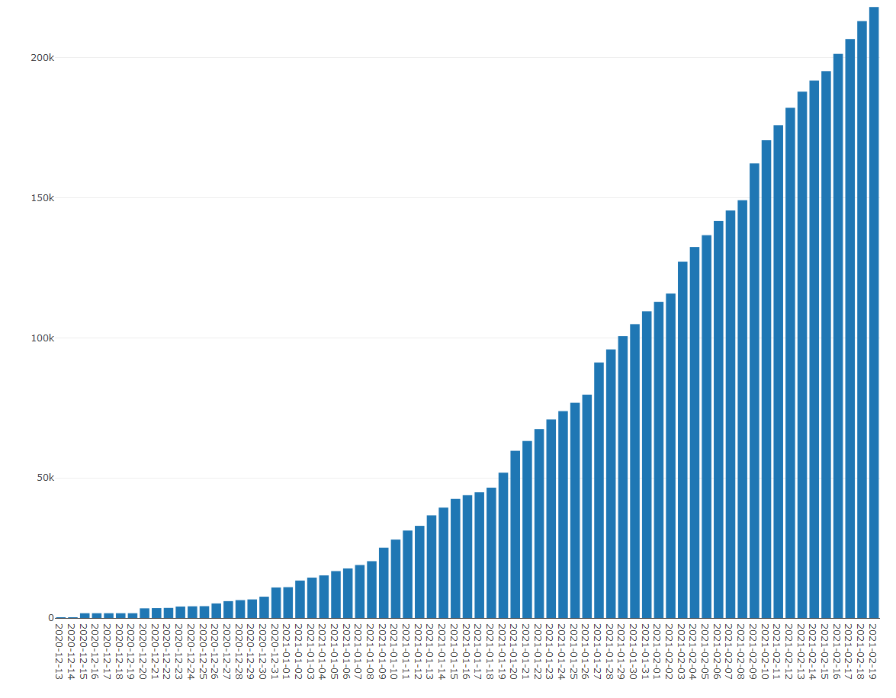
Daily global vaccination Progress (Accumulated)
Notes:
Who is pushing this Progress

Slide 8
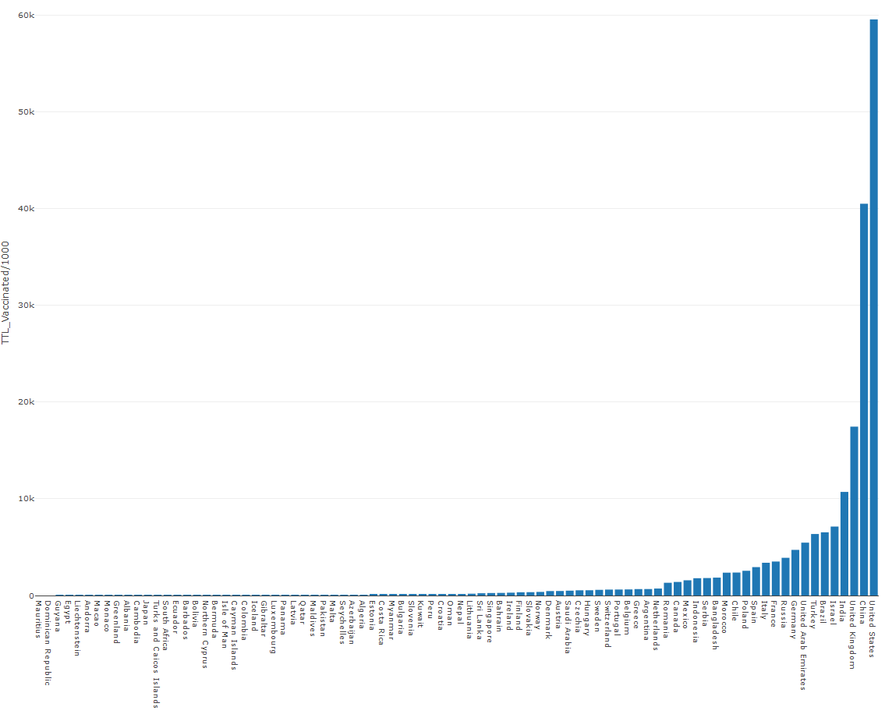
Country-wise Total Vaccination
Notes:
This graph is to show the total numbers of doses given to citizens in each country in its order.
US/China/UK/India/Israel are the 5 have given the greatest numbers of vaccines
It is also crucial to be mindful of vaccination progress in a ratio to population size, because obtainment of social immunity is one of major reasons of this human effort to vaccinate their citizens.
The more people get immunity against the virus in a society, the less would the virus spread be, broadly speaking.

Slide 9
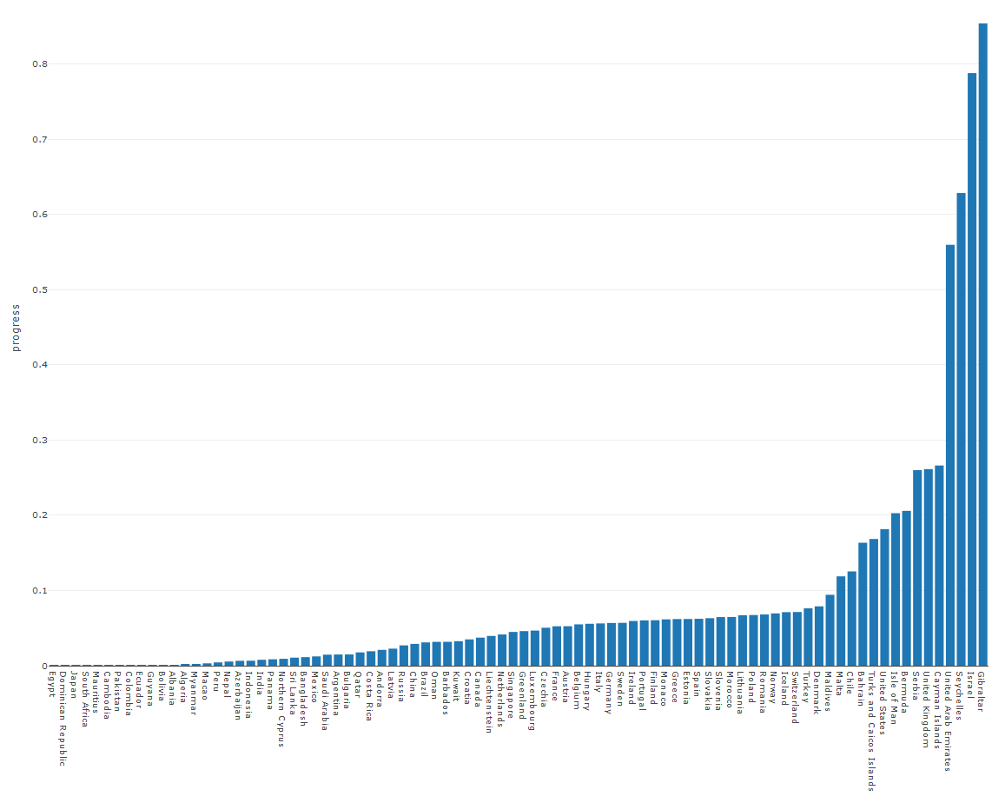
Doses per capita
Notes:
In this context, those small countries like Gibraltar, Israel, Seychelles, and UAE, are prominent and outstanding.

Slide 10
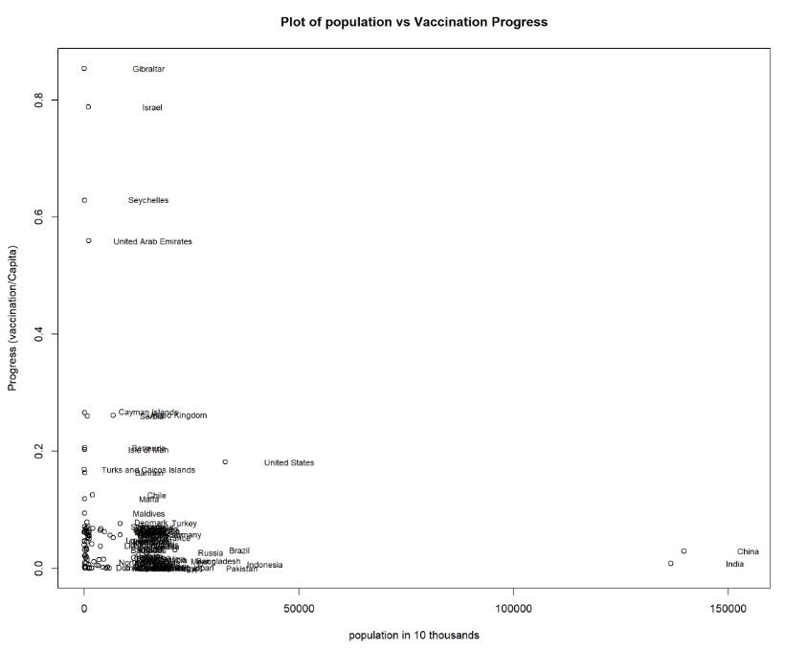
Notes:
In this plot, x-axis shows the population in 10-thousands and y-axis shows vaccination per capita.
Big populated countries, China and India are sitting on the bottom right, whereas those progressive countries in the figure of vaccination per capita are up on the top-right.
I hypothesized that this contrast rooted in the shortage of vaccine productions/availabilities.
The bigger the population is, the more difficult presumably would the security of vaccines for their entire population.

Slide 11
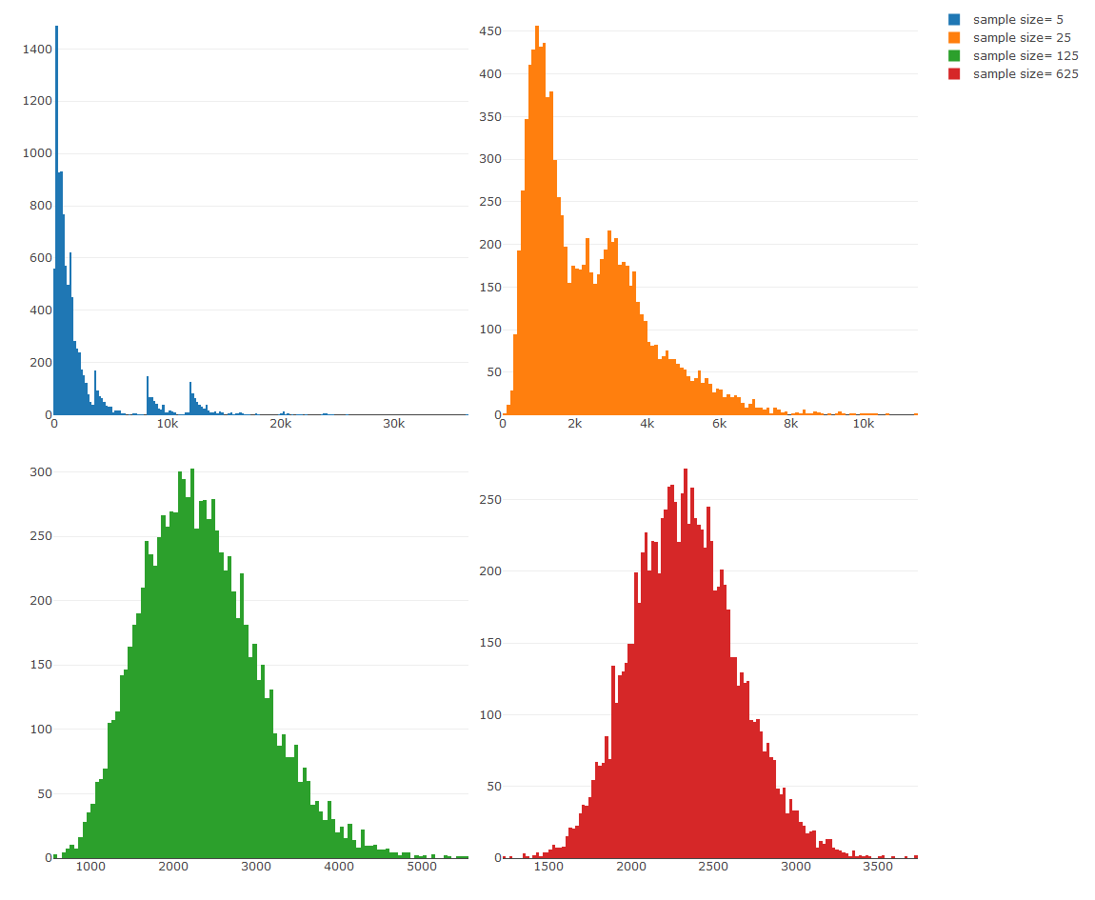
Random sampling and the Central Limit Theorem - TTL Vaccination
Notes:
The following histograms are to demonstrate the Central Limit Theorem.
I used three datasets; Total Vaccination, Vaccination Progress, and Population of each countries.
It visually proves that the more samples are taken, the narrower would the standard deviations be, whilst mean value stay the same.

Slide 12
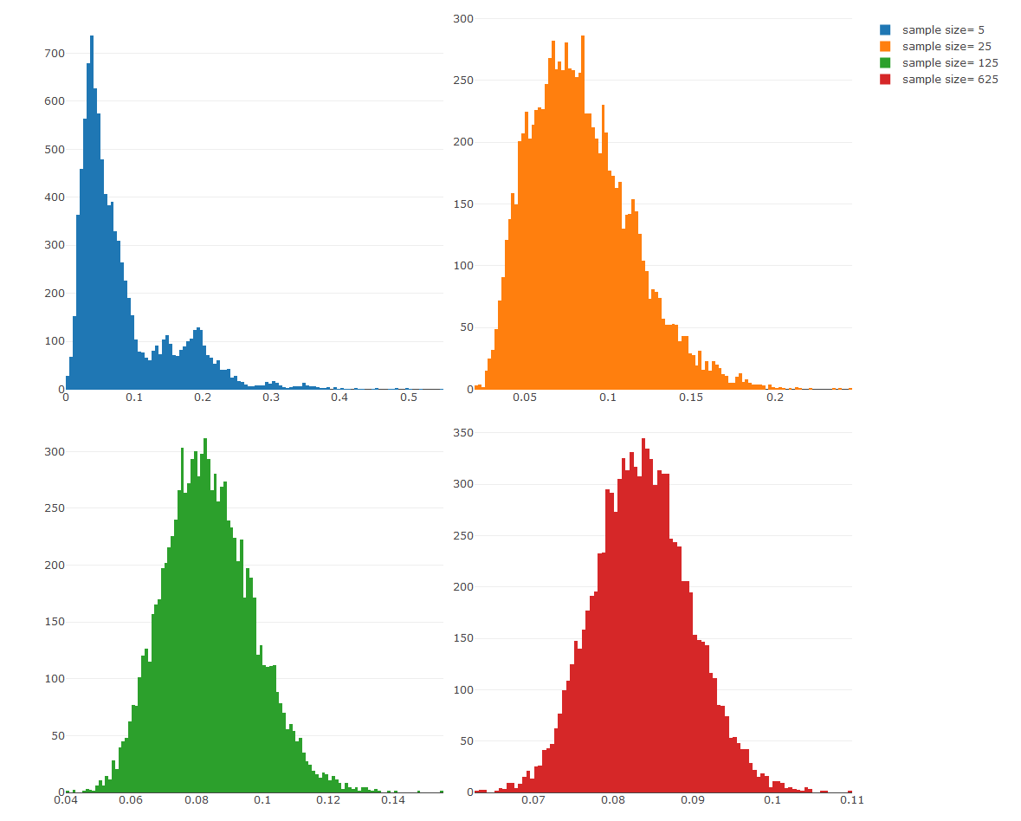
Random sampling and the Central Limit Theorem - Progress(Vaccination per Capita)

Slide 13
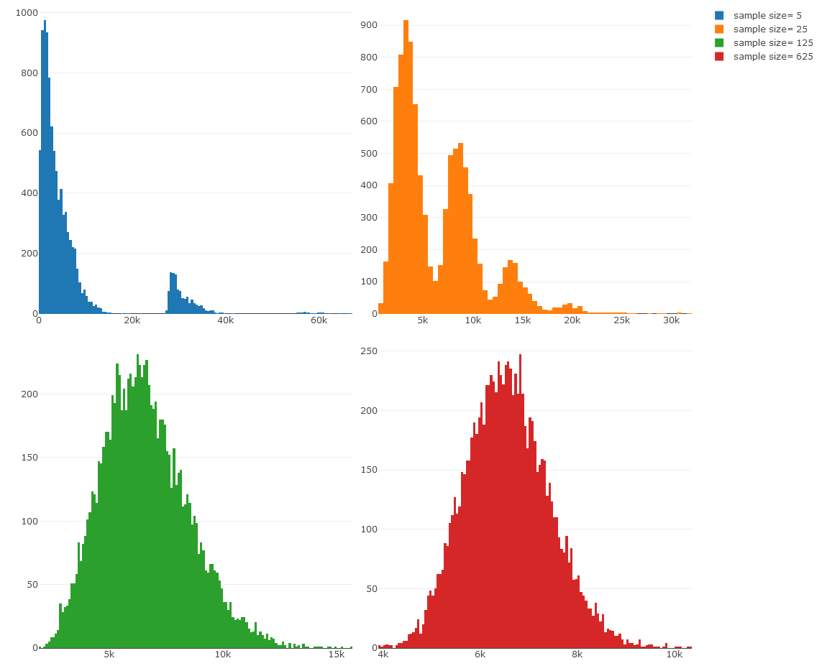
Random sampling and the Central Limit Theorem - Population(in 10ks)
Notes:
10k samples were taken for each experiment

Slide 14
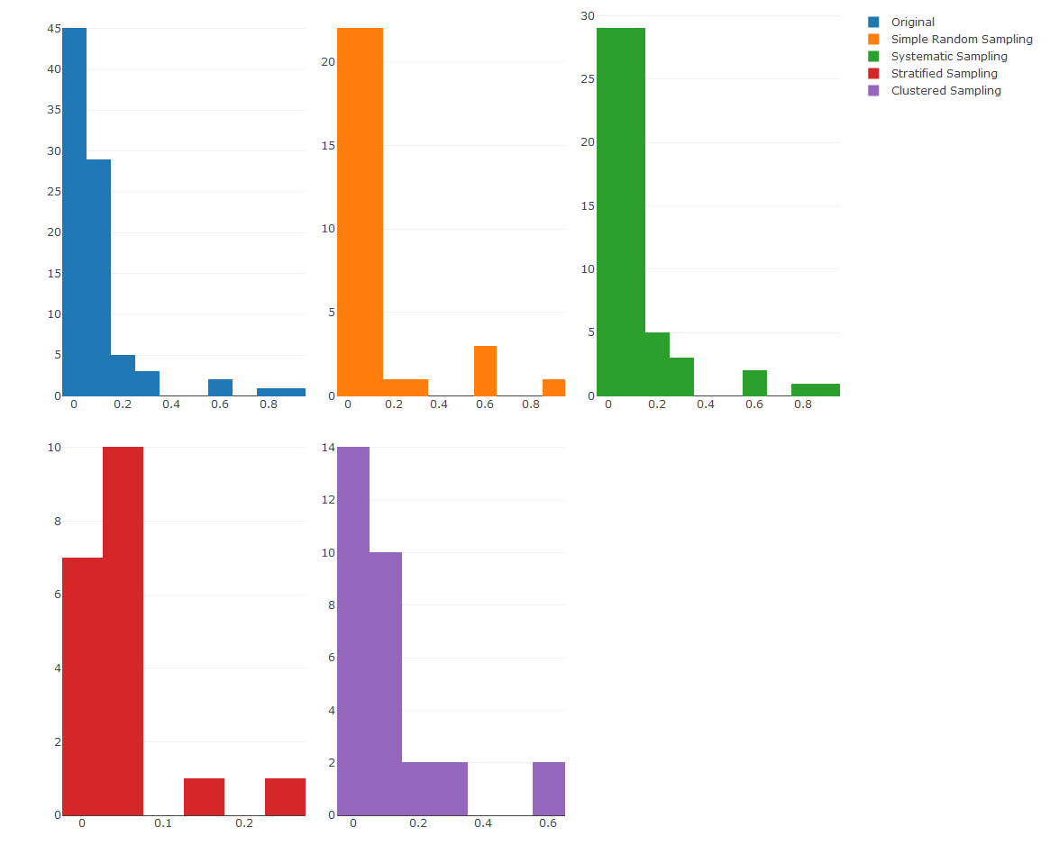
Sampling Methods
Notes:
This is the result of four different sampling methods, Simple Random Sampling WITH replacement, Systematic Sampling, Stratified Sampling WITH replacement, and Cluster Sampling, and compare the distributions with original histogram.
I interpreted from this analysis that, even if these samples were used instead of the whole dataset, the average of samples would have stayed the same, whereas the standard deviation would have been narrower than the whole original dataset.

Slide 15
Bootstrap Distribution: Standard Error of Median

